Slide 1


CIPET - Ahmedabad
Welcomes
Members of PMMAI and all participants
(25th July, 2014)

Slide 2

Central Institute of Plastics
Engineering and Technology (CIPET)
Department of Chemicals & Petrochemicals

Slide 3












Domains
Diversified activities, expertise and new initiatives in Academic, Technology Support & Research in the emerging areas of Polymer Science & Technology

Slide 4
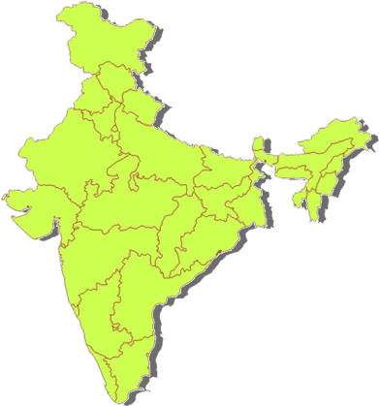





NATIONAL PRESENCE
HLC
Gujarat
Orissa
Tamil Nadu
Uttar Pradesh
Kerala
R&D Wings
ARSTPS - Chennai
LARPM - BBSR
Specialized Technology Centre
ATPDC – Madurai
APPTC – Balasore
PWMC - Guwahati
OLC
Andhra Pradesh
Assam
Bihar
Haryana
Karnataka
Madhya Pradesh
Maharashtra
Manipur
Punjab
Rajasthan
West Bengal
Vocational Training Centre
MCTI – BBSR
PDS Centre
IPFT - Gurgaon
Unique Institute of its kind in the whole of South East Asia – entire gamut of programmes & services in the field of polymers under one roof

Slide 5






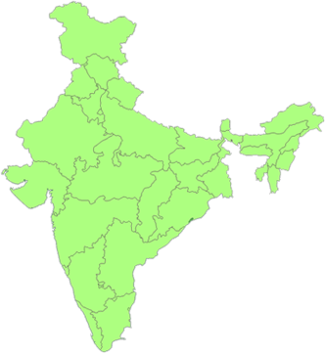





HIGH END PROGRAMMES
B.Tech in Plastics Engineering (4 yrs.)
B.Tech in Mfg. Engg. ( 4 Yrs.)
Intgtd. M.Sc. Tech. (Mat. Science Engg.) (5 yrs)
M.Sc. Bio-polymer Science & Technology(2 yrs)
M.Sc. Polymer Science (2 yrs)
M.Tech Plastics Engineering (2 yrs.)
M.Tech. Polymer Nanotechnology (2 yrs.)
ME (CAD/CAM) (2 yrs.)
Ph.D. Programmes

Slide 6
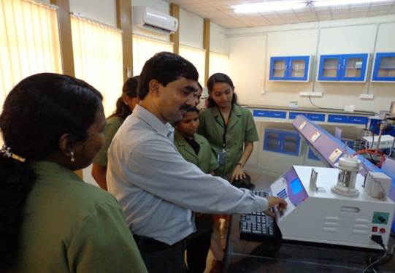
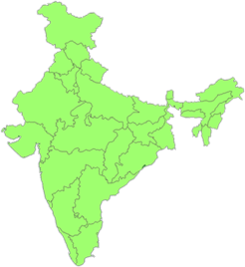
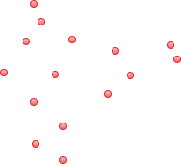
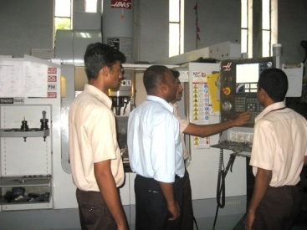


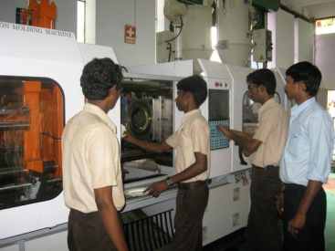


DIPLOMA PROGRAMS
Other Learning Centres
Diploma, Post Diploma, PG Diploma offered at all Centres

Slide 7
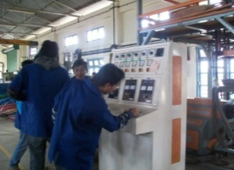
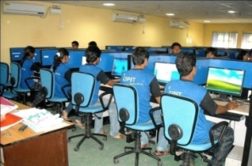

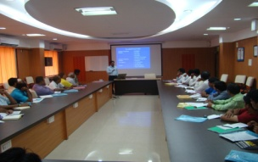
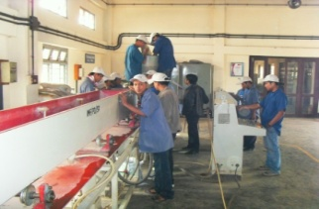


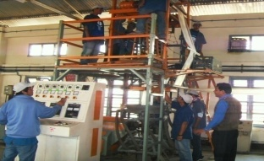
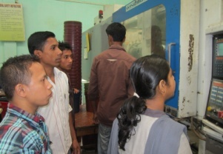

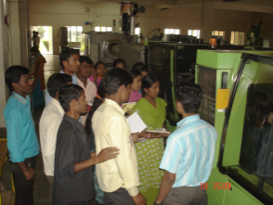
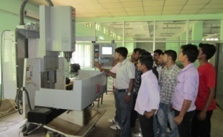
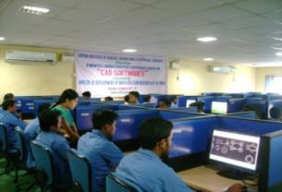
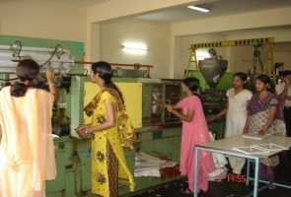
Skill Development Programs
Sponsored by Industries, MDoNER, SC/ST, Minorities Welfare Departments, Min. of Social Justice & Empowerment & other State Govt. Agencies

Slide 8



























International Collaboration
Faculty & Staff Exchange
Student Exchange
Cooperative Research
Exchange of Academic Materials
MoUs in Specific areas of Expertise – Biopolymers, Nanocomposites, Material Science & Engineering etc.

Slide 9













International Students
Saudi Arabia
Srilanka
Sultanate of Oman
Egypt
Algeria
Australia
Bangladesh
Kenya
Nigeria
Qatar
Nepal
UAE
Singapore

Slide 10

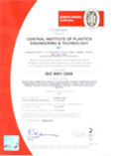
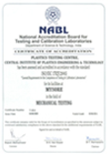
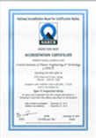




Technology Support Services
International Accreditation

Slide 11
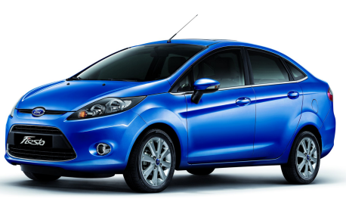
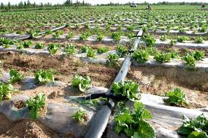
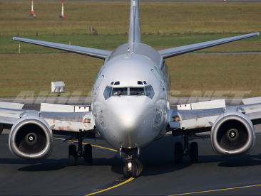


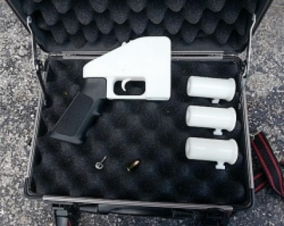
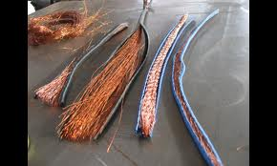
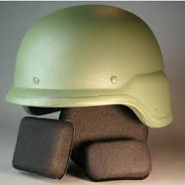
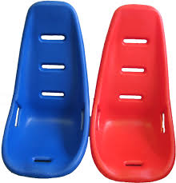
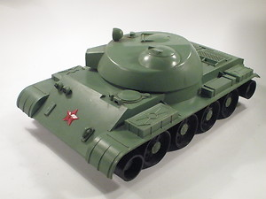
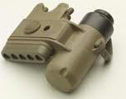
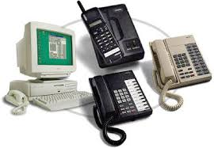
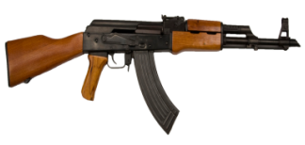
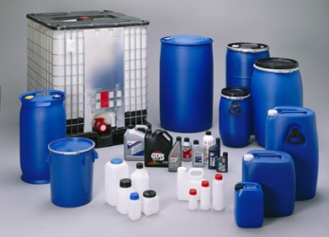
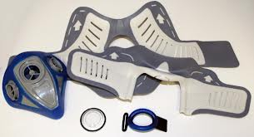



Technology Support Services
CIPET Offers its Technology Support services in all the key sectors
Automobiles
Agriculture
Aerospace
Building & Construction
FMCG
Information Technology
Teletronics
Defence
Packaging
Medical

Slide 12
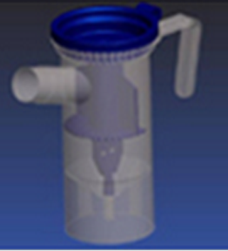
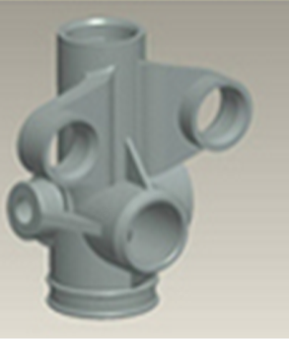
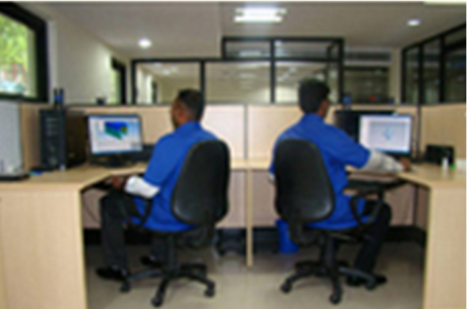
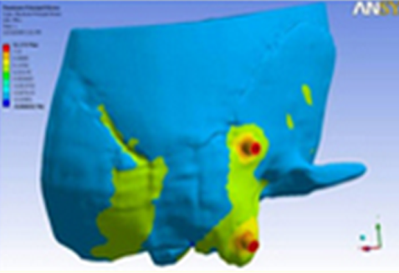
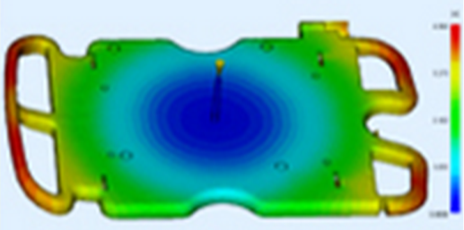
Technology Support Services
Infrastructure & Facilities - Design/CAD/CAM/CAE
MAJOR SOFTWARE RESOURCES
MASTERCAM
Solid Edge
IDEAS
CIMATRON
Pro - Engineer
NX-Unigraphics
CATIA
AutoCAD
ANSYS
Hypermesh
LS DYNA
Moldflow
Notes:
12

Slide 13
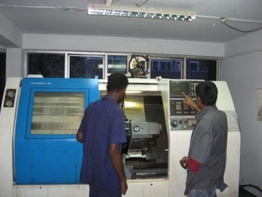
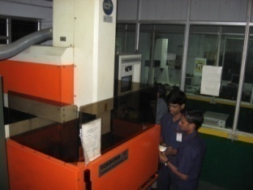
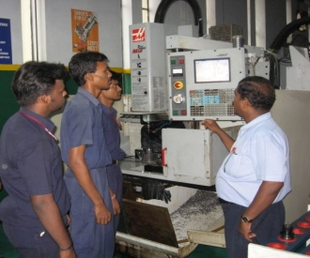
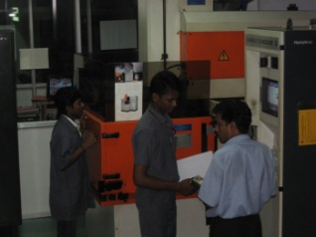
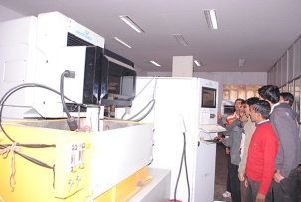
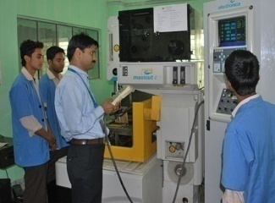
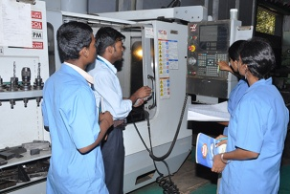
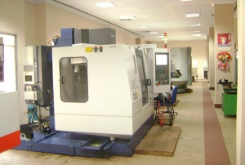
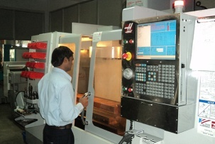
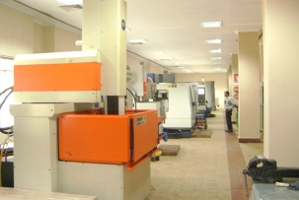
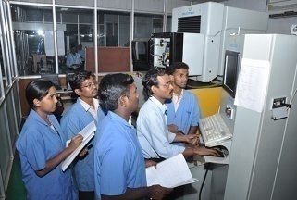
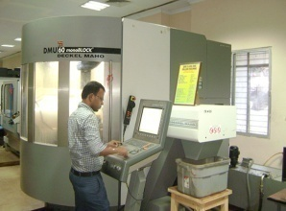
Technology Support Services
Infrastructure & Facilities – Tool Room
CNC Machines
• Universal milling and boring Machine
• Die sinking - EDM
• Universal lathe with hydrobar feeder
• High precision surface and profile grinder
• Wire cut EDM
• turning Centre
• Speed 5 Axis machining centre
• CNC EDM Spark erosion Machine
Special purpose Machines
• Jig boring machine
• Co-ordinate drilling and boring machine
• Center lathe with hydro copying attachment
• Rotary surface grinding
• Cylindrical grinder
• Optical profile grinding machine
Notes:
13

Slide 14



Technology Support Services
Infrastructure & Facilities – Processing
• Injection Moulding Machine (Micro Processor, All Electrical)
• Extrusion Stretch Blow Moulding Machine
• Single and Multilayer Film Extrusion
• Transfer, Compression Moulding
• Blending & Compounding
• FRP / Composite Products
• Recycling of Plastics Waste
Notes:
14

Slide 15









Technology Support Services
Infrastructure & Facilities – Plastic Testing
• Testing of Plastics materials and products as per National & International Standards through NABL accredited Laboratory for Mechanical, Thermal, Optical, Chemical & Rheological Properties
• Testing of Biodegradability as per ASTM, ISO Standards
• Micro-biological Studies on Plastics Products through Sterility Lab.
• Third party Inspection Services for Plastics & Allied Products for Quality Assurance (ISO/IEC – 17020)
• Technology Audit & Assessment of Plastics based Industry
Notes:
15

Slide 16
Technology Support Services
Infrastructure & Facilities – Calibration
Dimension |  | Vernier calliper, Micrometer, Dial gauge, Thickness gauge, measuring tape/Pie Tape/ Steel scale, height gauge
Temperature |  | Temperature controller, Temperature sensor, Temperature Indicators, Glass thermometer, water bath
Volume |  | Burette/ pipette/ Measuring Flask, RD Bottle etc.
Time & RPM |  | ass thermometer, water bath
Pressure, force and Mass |  | Pressure gauges, Load Cells (UTM), Tensile and Compression machine, Weight Box and weights, Electronic Balance, Spring Balance
Electrical calibration |  | ACV/DCV – Voltmeter (AC & DC) ACI/ DCI – Ammeter Resistance – Ohm-meter DCI/ Resistance – Multi meter Frequency – Frequency Controller Capacitance – LCR Meter Insulation – 100 M 2G M Insulation Resistance – Resistance tester Power (AC/DC) – Wattmeter
Notes:
16

Slide 17




Technology Support Services
DESIGN AND DEVELOPMENT OF MODULAR PROSTHETIC APPLIANCE

Slide 18






Technology Support Services

Slide 19




Technology Support Services

Slide 20



Technology Support Services
Press Tool for the Gear Cover Sheet Metal used in Crew Cabin

Slide 21





Technology Support Services
Molds for Indian Railways – Signal Communication
Assembly View of all three components
Single Cavity Transfer Mould for Bakelite Plug board
Single Cavity Injection Mould for Polycarbonate cover
Single Cavity Compression Mould for Bakelite Base

Slide 22











Technology Support Services

Slide 23







Technology Support Services

Slide 24













Technology Support Services
First Educational Institution in the Country to be certified as per ISO/IEC: 17020
CIPET Widens its Scope for Export Inspection Across the Globe

Slide 25

















Technology Support Services

Slide 26




R&D Wings
Research & Development
Laboratory for Advanced Research in Polymeric Materials (LARPM)
Advanced Research School for Technology & Product Simulation (ARSTPS)

Slide 27
Objectives
Solution to Engineering Problems
Collaborative Research
Consultancy Services
International Integration
Technology Development & Transfer

Slide 28







Focused Areas
Biopolymers
Polymer Blends & Alloys
E-waste Recycling
Conducting Polymers
Biosensors
H₂ Separation
CNTs
Shape memory polymers
Nanocomposites
PEMs

Slide 29







Focused Areas
Rapid Prototyping
Reverse Engineering
Product Design & Development
Redesign, Failure Analysis & Reliability Studies
Redesign and Design Optimization
Failure Analysis and Reliability Studies
Computer Simulation and System Modeling
Manufacturing Process Simulation & Analysis
Stress & Vibration Analysis

Slide 30









Centre of Excellence
CIPET India
Univ. of Toronto Canada
CoE

Slide 31







Centre of Excellence
CoE
Sustainable Green Materials

Slide 32


Polymer Data Services

Slide 33

Mission
    “To provide the right resources at the right time to facilitate our members to raise their business potential by interlinking them through our database & services.”

Slide 34

Vision
“To inspire individual and organizations to achieve high standards by adding value to the products and services which helps them to enhance and create opportunities to capture the market and perform
AT-PAR.”

Slide 35









Business Executives
Anil Kr. Namdeo
Region wise
Saiyed Sohelahmed
Kaushal P. Sahoo
Akshay Dixit
Ankit Bhatnagar

Slide 36


Service to Society
CIPET
Technical Support
Business Support
Consultancy
Research
support
HRD
Events Management

Slide 37


