Slide 1

Capital Goods Skills Council
PMMAI Workshop: Ahmedabad 25th July 2014

Slide 2
Is availability of skilled manpower your business concern?

Slide 3
Skill India Not Scam India
Skill for Employability not Certification
Speed- Scale - Skill
PM Shri Narinder Modi

Slide 4

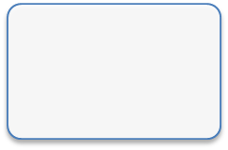
Structure of Skills Development
Skills Development Ministry
In addition - 17 other Central Ministries and All State Govts involved
Msn: Skill 500 Mn by 2022
NSQF
National Skills Development Agency (NSDA)
Private Sector
NSDC
Functions of Sector Skills Council:
Research Labour Market Information
Set up Occupational Standards and Quality Assurance.
Promote CoEs
Assessment and Certification
Sector Skills Council - A
Sector Skills Council - B
Sector Skills Council - C

Slide 5
What is a Sector Skill Council
Sector Skills Councils (SSCs) employer-led organisations that cover specific economic sectors. They have four key goals:
  to reduce skills gaps and shortages
  to improve productivity
  to boost the skills of their sector workforces
  to improve learning supply.
Essentially these bodies have been created “By the Industry and For the Industry”

Slide 6

Capital Goods Sector Skill Council (CGSC)
Registered as a Society.
Promoted by FICCI and Co-promoted by DHI, with funding support from NSDC and industry.

Slide 7
Key Segments
Initial focus is on the following segments of Capital Goods Sector:
  Machine Tools
  Process Plant Equipment
  Dies Moulds and Press Tools
  Plastic Machinery
  Textile Machinery
  Light Engineering
  Power Equipment

Slide 8
Typical Representation in SSC
Industry members
Industry
associations
Distinguished business leaders
Training Providers
NSDC
Trade Unions
Govt Bodies
SSC

Slide 9
CGSC Governing Council
Following organization's together form the Governing Council:
L&T | Thermax | Bharat Forge | BHEL | ALSTOM
HEC | GW Precision | HMT
IMTMA | PMMAI | PPMAI | TAGMA | TMMA
EEPC | ITAMMA
FICCI | DHI | IIT-Delhi | NSDC

Slide 10
Members of Governing Council
Chairman Mr K Venkataramanan Chief Executive Officer & Managing Director Larsen & Toubro Ltd | Mr. A. Didar Singh Secretary General FICCI
Mr. RK Singh Joint Secretary Dept of Heavy Industries, Govt of India | Mr M.S. Unnikrishnan Managing Director & CEO Thermax Ltd
Mr Sunil Chaturvedi Executive Director & COO (Capital Goods Division) Bharat Forge Ltd | Mr R. Misra Chairman cum Managing Director HEC Ltd
Mr. Tosher G Hormusjee Director G W Precision Tools India Pvt Ltd | Mr. Sunand Sharma Country President - ALSTOM India Chairman - ALSTOM Projects India Limited
Mr K K Seth Executive Director (HRDI, CPG & NIC) Bharat Heavy Electricals Ltd. | Mr B Sarkar Executive Director EEPC India
Mr. N K Dhand Managing Director,Micromatic Grinding (IMTMA) | Mr. N K Balgi President , Ferromatik Milacron India Pvt. Ltd. (PMMAI)
Mr. K. Nandakumar CMD, Chemtrols Industries Limited (PPMAI) | Mr. N. Reguraj Managing Director, NTTF (TAGMA- INDIA)
Mr Prakash K. Bhagwati Chairman, InspirOn Engineering Pvt. Ltd. (TMMA) | Prof S K Koul Deputy Director (Strategy and Planning) IIT-Delhi
NSDC Nominee Director | Mr ND Mhatre DG (Technical), ITAMMA

Slide 11
Objectives
Develop National Occupational Standards
Develop Sector Skill Development Plan
Develop Quality Assurance parameters for assessments and certification.
Training of Trainers
Promote academies of excellence for the sector
Establish structured Labour Market Information System (LMIS)

Slide 12
What are National Occupational Standards?
National Occupational Standards (NOS) specify the standard of performance an individual must achieve when carrying out a function in the workplace, together with the knowledge and understanding they need to meet that standard consistently. Essentially NOS are benchmarks of good practice.
These can be easily called the Assessment Standards.

Slide 13
What are NOS used for?
Although NOS are often used to build qualifications and training programmes, sectors, organisations or individuals can use NOS as the platform for almost any other aspect of human resource management and development, for example:
  workforce planning
  performance appraisal and development systems
  job descriptions
  workplace coaching
  Up skilling of existing manpower

Slide 14
Points to be kept in Mind
Role of each sub-sector and identify its uniqueness with respect to others in Manufacturing Sector.
Tech Job Roles – why are these “so specific” to Capital Goods Sector when compared to others in Manufacturing or other sectors
Eg .. Welding is common to Construction, Auto and other sectors and also Capital Goods.. What is the CG Sector’s unique requirement? What is the KEY PURPOSE of the Welder in CG Sector / Sub Sector?

Slide 15
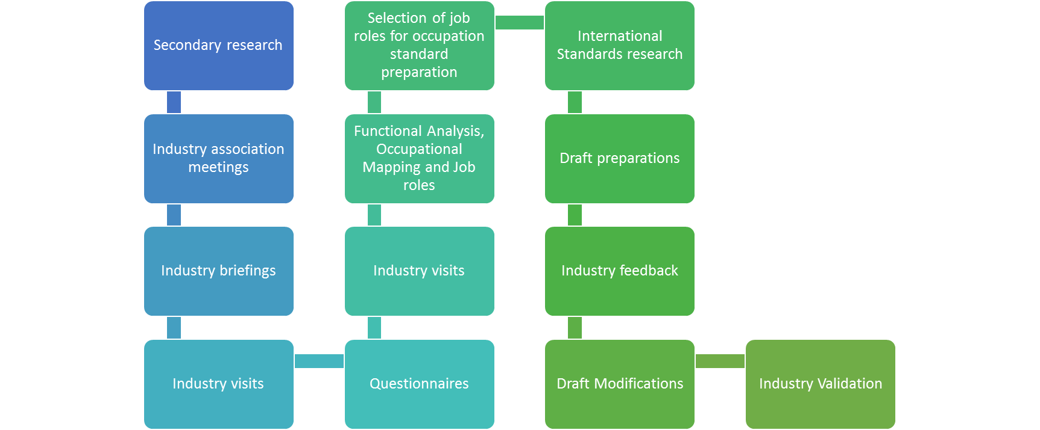
Methodology Followed:
Development of Occupational Standards

Slide 16
Sector Occupational Map
Typical Occupational Standard

Slide 17
Industry Validations
All Occupational Standards to become National Occupational Standards must be validated by 30 companies each (10L/10M/10S)
Validation includes comments for improvement + sign off by each of the 30 companies

Slide 18
Skills Value Chain & Challenges
Sourcing
Training Standards & Content
Training
Assessment & Certification
Placement
Infrastructure
Trainers and Training of Trainers
Funding

Slide 19
How will this Work
TRAINING NEED ANALYSIS
CURRICULUM DEVELOPMENT
ROLLOUT OF TRAINING
ASSESSMENT AND CERTIFICATION
CREATE OCCUPATIONAL
STANDARDS AND
COMPETENCY LEVELS
FOR JOB ROLES (NVEQF)
ACCREDITATION OF
TRAINING INSTITUTES
ASSESSMENTS
AND CERTIFICATION
OF TRAINERS
AND TRAINEES
SSC

Slide 20
Your Contribution
Provide inputs for Occupational Standards
Validate the Occupational Standards
Sign a broad based MoU with intent to:
  Acceptance of the Occupational Standards
  Share six monthly demands for skilled manpower
  Provide preferential employment to CGSC certified people
Share names of credible training providers
Share contacts of retired industry people who could be engaged as Assessors

Slide 21
Thank You

