Slide 1

CII’s New Manufacturing Sector initiative
Mr Ram Mohan & Dr Sarita Nagpal
Presentation to PMMAI
25th July 2014

Slide 2
GTC100 Vision (2013-2014)
To enable small and mid-size companies
to grow to the next level

Slide 3
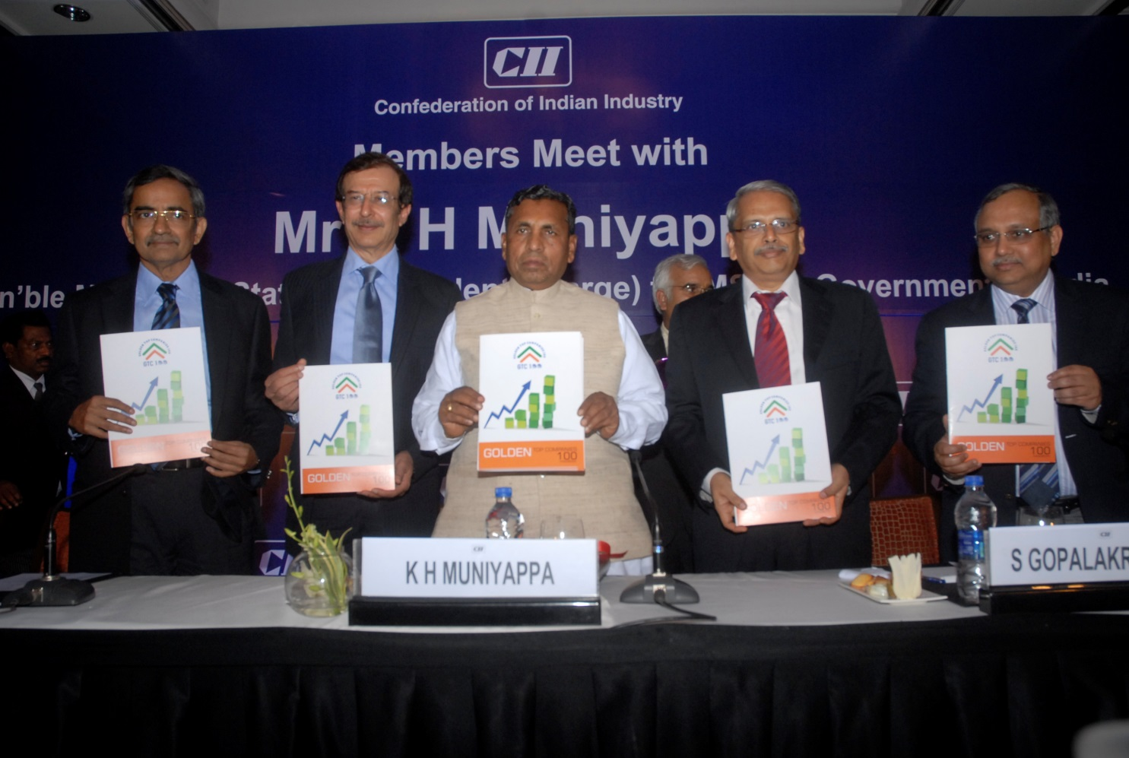
GTC100 Launch : 4th July 2013, Bangalore
Project launched on 4th July 2013 in Bangalore, in presence of
Shri K H Muniyappa, Hon'ble Minister of State,
Ministry of Micro, Small and Medium Enterprises

Slide 4
CII Basic Cluster Roadmap
Product & Plant Quality
Energy Audit
Cost management
Problem solving
Poka Yoke
Reliable Quality &
Delivery at low cost
Management System Quality
Shift Management
MIS - Key Indicators
Visual Factory
P
Good Management
Practices
A
D
Equipment Quality
Model Machine
Breakdown Reduction
SMED
Competitiveness
Healthy
Equipments
C
Employee Quality (TEI)
3M
5S
Safety Management
Suggestion Scheme
Motivated
Employees

Slide 5
CII Advanced Cluster Road Map for Competitiveness
Input
Process Result
Impact
Takt Time
Lean
Stability in process
Lean
Kanban linkage
Reduced lead time
Thinking
Logistics
Customer satisfaction
Autonomous maintenance
Zero breakdown
Planned maintenance
TPM
Zero defect
Paradigm
Quality maintenance
Production increase
Shift
Kobetsu Kaizen
OEE increase
Cell layout
Value added to employee cost
Single component flow
Productivity
Job enlargement
Productive
Multi machine manning
improvement
Work culture
Process ownership
Red tag
High ITR
SMED
Inventory
Improved
Management
Working capital mgmt
Cash flow
Containerization
Standards
In-house rejection
Process capability
Quality
Warranty claims
Quality
Management
Excellence
Poka Yoke
Customer complaints
5S
Daily management discipline
3M
5S
Improvement
Waste elimination
Culture
My machine
Operator ownership
campaign

Slide 6
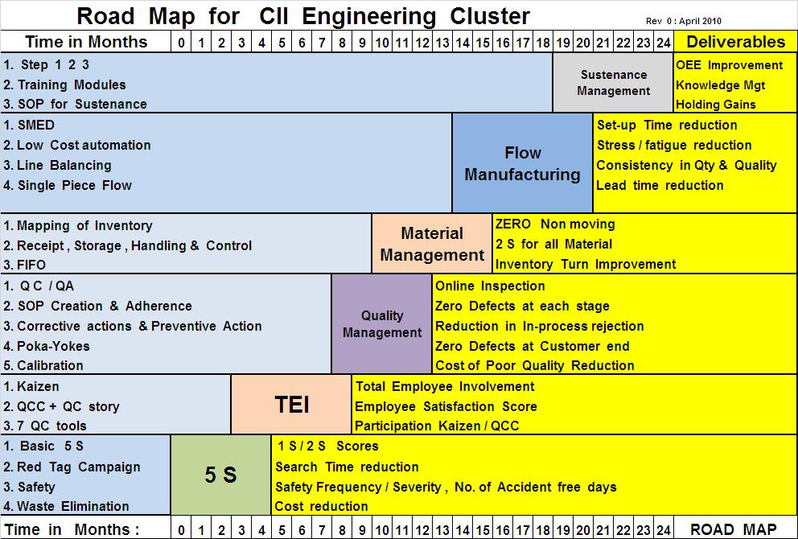
GTC100 Vision
Conceived as
an initiative for aspiring Indian SMEs to
grow by transforming from
small m to BIG M

Slide 7
Framework for Manufacturing Growth small m to BIG M
Technical Change
Global Change
Regulatory Change
Supply Chain
Customer’s
Apparent
and
Latent Needs
Product
Design
After Sales
Service/
Warranty
R&D
Small m
Business
Change
Suppliers
Manufacturing Process Change
Societal Change
Environmental Issue
7
Notes:
7
India is migrating from a small M to a Big M paradigm. Even our SMEs have to move towards the Big M picture to be successful in Manufacturing. This means not only producing to a drawing but also innovating, developing products, becoming a part of global supply chain etc.

Slide 8
GTC 100 – 7 Step Implementation Process
1. Companies are interested
2. Do Preliminary Assessment to assess need & current level
3. Develop customized road map in the chosen stream
4. Agree on Milestones and Outcomes
5. Launch Project
6. Celebrate success
7. Plan for next phase of growth

Slide 9
GTC 100
GTC 100:
The future

Slide 10
GTC 100
New Ideas & Discussions

Slide 11
GTC 100
Thank you!

