Slide 1

PMMAI : OPEN HOUSE
11th Aug, 2016 : Ahmedabad
Presented by : Vinay Bansod

Slide 2
Status of activities
F14-15 : ARMOUR & SPRINT Updates
Objective:
- Enhance Safety of Machines
- Restrict “Unsafe” machine import
- Quality/Reliability Improvement
- Increase Export to developed countries
- Identity of our Industry / Region
World is following EUROPEANS

Slide 3
Major Plastic Markets : Worldwide
F14-15 : ARMOUR & SPRINT Updates
North America - ANSI
South America - ABNT
Europe – DIN, UNI, AFNOR - CE (EN201)
China – SAC (GB22530)
South East Asia – KCS
Japan – JISC
Africa & ME – N.A.
India – N.A.
World is following EUROPEANS

Slide 4
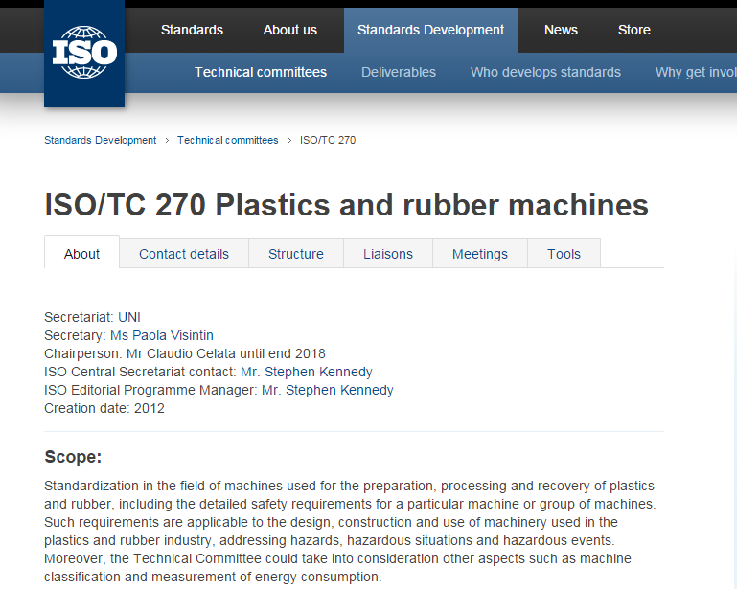
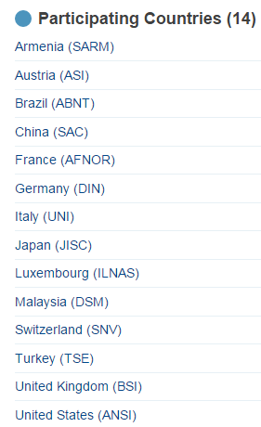
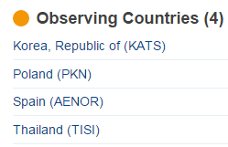
Role of ISO
F14-15 : ARMOUR & SPRINT Updates
Quality, Safety, Efficiency
ISO/TC 270 - Standard for IMM
BIS: participation in ISO meeting
Help to get “P” or “O” status
Draft a common Standard for the world

Slide 5
European Standard
F14-15 : ARMOUR & SPRINT Updates
EN60204-1 - Safety of Machinery : Electrical Equipment of Machines
Part 1 : General Requirement
Incoming supply conductor terminations
Protection against electrical shock
Protection of equipment
Control circuits and control functions
Operator interface
Electronic equipment
Controlgear: location, mounting and enclosures
Conductor and Cables
Wiring practices
Electric motors and associated equipment
Marking, warning signs
Technical documentation
Testing and verification

Slide 6
Cable sizes
F14-15 : ARMOUR & SPRINT Updates
Minimum Cross Section Area |  | 1 Core |  | 2 Core |  | 3 or more Core
 |  | Stranded | Solid | Shielded | Un-Shielded | Shielded / Un-Shielded
Outside Electrical Cabinet (Machine wiring) | Non Flexing Power Wiring | 1 | 1.5 | 0.75 | 0.75 | 0.75
 | Connections with frequent movement | 1 | - | 1 | 1 | 1
 | Control circuit Wiring | 1 | 1.5 | 0.3 | 0.5 | 0.3
 | Data Communication Wiring | - | - | - | - | 0.08
Inside Electrical Cabinet (Panel wiring) | Non Flexing Power Wiring | 0.75 | 0.75 | 0.75 | 0.75 | 0.75
 | Control circuit Wiring | 0.2 | 0.2 | 0.2 | 0.2 | 0.2
 | Data Communication Wiring | - | - | - | - | 0.08
All cable sizes in mm²

Slide 7
Applicability of Standard
F14-15 : ARMOUR & SPRINT Updates
AC | Below 1000 Volt
DC | Below 1500 Volt
Frequency | Below 200 Hz
Earthing Cable : Cross Section Guidelines
Supply cable size (S) | Earthing cable size
S ≤ 16 | S
16 < S ≤ 35 | 16
S > 35 | S/2

Slide 8
Common Cable Colour Codes
F14-15 : ARMOUR & SPRINT Updates
EN60204-1 - Safety of Machinery : Electrical Equipment of Machines
Start up activity to Standardise cable color codes among Core team members
Earthing . . . . . . . . . . . . . . . . . .
Neutral . . . . . . . . . . . . . . . . . . .
AC or DC Power circuits . . . . . .
AC Control circuit . . . . . . . . . . .
DC Control circuit . . . . . . . . . . .
Will ISO address this? Follow European colour codes.

Slide 9
Standard Interpretation : EN201
F14-15 : ARMOUR & SPRINT Updates
Risk assessment on general safety – In and around the machine
Hose chains
Guards/covers in Clamp and Injection area
Safety relay and positive break limit switches
Filters for drive and heaters
Clamp hydraulic safety with active cartridge monitoring (spool movement monitoring)
Electrical wire colour codes
Many reference standards

Slide 10
Action Points
F14-15 : ARMOUR & SPRINT Updates
Adaptation of Standard in 2-3 steps in 3-4 years (safety standards should be acceptable to all)
Precedence to “Human Safety” followed by “OHSAS” & “Environment Safety”
Pilot project for IMM
IMM : Windsor, Milacron, Electronica, ASB, Toshiba, PolymechPlast
Refer European, Japanese & American standard and prepare our check list for all safety considerations
Audit High end Chinese/Taiwanese IMM

Slide 11
Status of activities
F14-15 : ARMOUR & SPRINT Updates
Meetings:
Jul 5, 2016 | Toshiba, Chennai
Aug 2, 2016 | New Delhi (DHI/BIS/PMMAI)
Aug 8, 2016 | Electronica, Pune

Slide 12
DHI/BIS/PMMAI meeting updates
F14-15 : ARMOUR & SPRINT Updates
“P” or “O” status (ISO) : 19th Sep, 2016
Copy of Standards from BIS library (Anu, RR)
DHI funding (70 to 80%) for purchase of standards (2L for purchase of Normative standards)
No Indian Safety standards for machinery – BIS (NLG to get info on Milling/Lathe machines)
BIS to do Standard sequencing based on draft. Standard copy in wide circulation in Industry
Release of standard : 1 year from Draft
DHI can make it a regulatory standard (min 3 months from date of release)
EN60204-1 Standard in printing
Harmonic levels : Guidelines can be prepared

Slide 13
Timeline of activities : Draft of a Standard
F14-15 : ARMOUR & SPRINT Updates
Activity | Timeline
Study of CE, ANSI, JIMS | Completed
Purchase of Normative Standards | Aug 20, 2016
Compilation of Checklist (CE, ANSI, JIMS) | Aug 25, 2016
Study of Far east machines | Aug 30, 2016
Study of Normative Standards | Oct 5, 2016
Recommendations with Price indication and approval from HOC | Nov 10, 2016
Preparation of DRAFT and submission to BIS | Dec 31, 2016

Slide 14
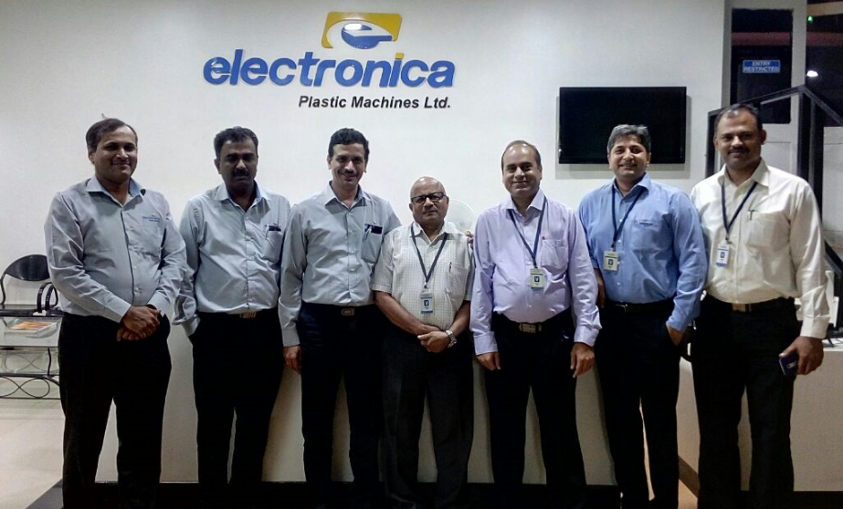
F14-15 : ARMOUR & SPRINT Updates
Thank you

