Slide 1

SYNERGY : CO-CAB
So far so good What next???
11th August , 2016
Ahmadabad.

Slide 2
About PMMAI
F14-15 : ARMOUR & SPRINT Updates
Recap
Plastics Machinery Manufacturers Association of India (PMMAI)
Is an industry body representing all plastics machinery manufacturing organisations in India
Objective : Promoting advancement of this industry-sector in India.
Member : comprises manufacturers of primary processing machinery, post-forming
processing machinery, and auxiliary equipment used in pre and post-forming operations.
Vision & Mission
Vision
To be a global player providing world class products at competitive prices, contributing to the success of the plastics processing industry and be their preferred supplier of machinery.
Mission
We shall work continuously for Indian plastics machinery to be world class in terms of Quality, Technology, Cost competitiveness and Process standards through an inclusive and cooperative approach to create value for the plastics processing industry.

Slide 3
Business proposition- common procurement platform
F14-15 : ARMOUR & SPRINT Updates
PMMAI together with its strategic members formed the Central Procurement System in August 2015.
Standardizing the product varieties, which will provide ease to suppliers and even the MSME sector will be slowly adopting the global standards.
Learning & sharing of best practices amongst members for overall industry development.
Consolidate the commodity spend and leverage the bundled volumes to create a Win-Win alliance with prospective business partners ( Vendors) and PMMAI + Members.
Help to elevate and enhance Indian product standard & quality at global markets through process improvements and support in operations management.
Through our LEAN initiative we will facilitate co-existing with supplier with sustained program to raise quality, to reduce cost and shorten delivery time.
Recap
Objectives :

Slide 4
Central Purchase System (Synergy Co-Cab)
F14-15 : ARMOUR & SPRINT Updates
Cable is one of the key commodity commonly used
Approx. Over 8000 KM consolidated volume per annum with YOY increase with business / sector growth
Possibility of expansion within the group & with new members
Common point of interaction
Savings in marketing & sales expenses to the vendor
Increase in Brand value
Expansion opportunity to cope-up with the demand
Sustainable Business
High level of standardization and modularization targeted.
Recap

Slide 5
Our Expectations from Vendors
F14-15 : ARMOUR & SPRINT Updates
Long term engagement on sustainable terms
Setting up Kanban for PMMAI inside your setup for fast response time
International standard product in terms of quality & reliability
On time supplies
Competitive & Stable pricing
Prompt after Sales support
Flexibility & adoptability
Constant Upgradation of Technology and service standards
Recap

Slide 6

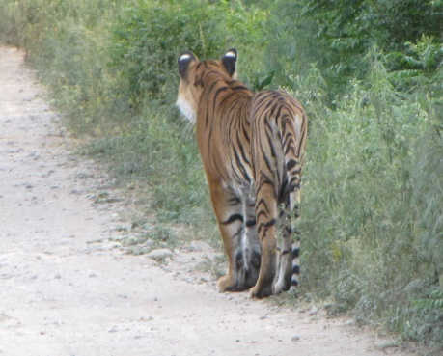
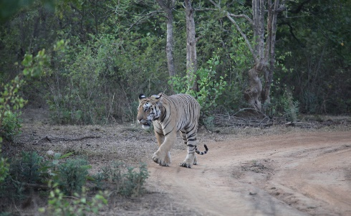
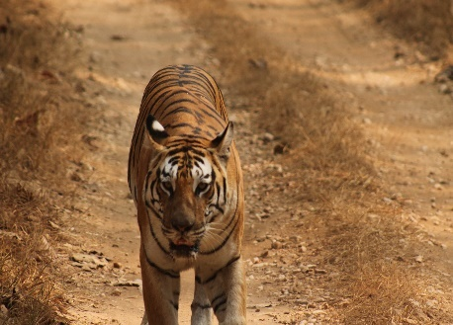
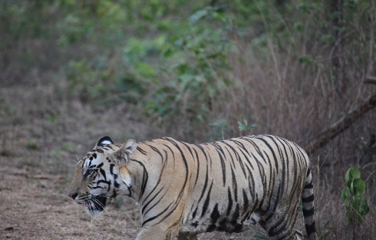



The COCAB Team -
F14-15 : ARMOUR & SPRINT Updates
Shirish Divgi –COCAB Leader.
Kishore Singhi & SNJ Aradhya- Key negotiators.
Vinay Bansod & Yash Parikh- Statistical input .
Technical & commercial Support-
Prem Kumar VRJ, Utsav Doshi, Arun Kumar Chari.
PMMAI management support by,
Subba Bangera & Anu Chaudhary.

Slide 7
Results so far.
F14-15 : ARMOUR & SPRINT Updates
All terms of contract clearly worked out and communicated.
4 key supplier plants visited and capability ratings done.
Expectation communicated to short listed vendors.
Three vendors( LAPP, RR cable and Polycab) have shown interest.
All the vendors have gone through multiple level of quoting.
The expectation to vendor response GAP is narrowing.
Once executed clear benefits will be seen.

Slide 8
Way forward,--
F14-15 : ARMOUR & SPRINT Updates
Benefit at different slabs to be communicated to interested members.
The terms agreed with the vendor to be communicated to interested members.
PMMAI fees to Members based on their offtake has to be determined.
Members to be trained on standardization of cables.
PMMAI to create a common purchase platform of cables to the tune of 30 crores in a year through 3 vendors.

Slide 9
Gist of terms & condition..
F14-15 : ARMOUR & SPRINT Updates
TERMS & CONDITIONS
60 days payment terms .75 days there will be alarm and reaching 90 days supply will stop.
Vendor has to confirm back to PMMAI on Price Variation clause applicable for copper, for any variation of +/- 4-5 % .
All deliveries at manufacturing units.
Vendor will review the contract until 31.03.2017 for off-take. Validity of the contract not before 30.06.2017.
Based on forecast vendor will maintain KANBAN stock for PMMAI
MOQ turn to PACK size.
Delivery terms:
Vendor will follow as per their quote.
AIR FREIGHT cost will be at actual and extra for trading items , if needs on urgent basis .
PMMAI members who are placing orders through their panel builders should submit purchase order/BOM copy to vendor.

Slide 10
Price Benefits to Members
F14-15 : ARMOUR & SPRINT Updates
Members have given purchasing figures of 0.5sq.mm, single core cable ranging from Rs. 4.20/- per metre to Rs. 2.60/- per meter.
We today have final offer of range from Rs.2.85/- per metre to Rs. 2.47/- per metre.
In addition, we have a Turn Over Discount ranging from 0.5% (Rs.25lacs per annum) to 2% (Rs.1.5crore per annum) based on volumes.
Also committed is Just in Time delivery (JIT) with KANBAN for PMMAI within the plant.
100% International Quality is guaranteed.

Slide 11
Recognition of efforts
F14-15 : ARMOUR & SPRINT Updates
My special thanks to,
SNJ for helping in drafting RFQ and MOUs,
Yash and Vinay for the documentation, statistics and systematic feedback
Arun Kumar Chari for his vigilance.
SNJ and Singi for their negotiation skills.
Moreswar for his last minute effort with LAPP,
And above all ANU for her persistent approach to make it a success.
And all other members for their special contribution.

Slide 12
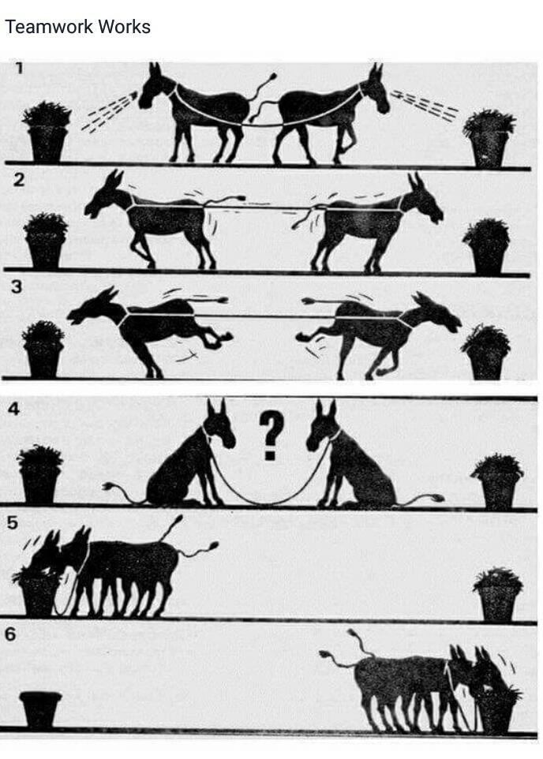
Way forward,-- collective coexistence
F14-15 : ARMOUR & SPRINT Updates

